Slide 1
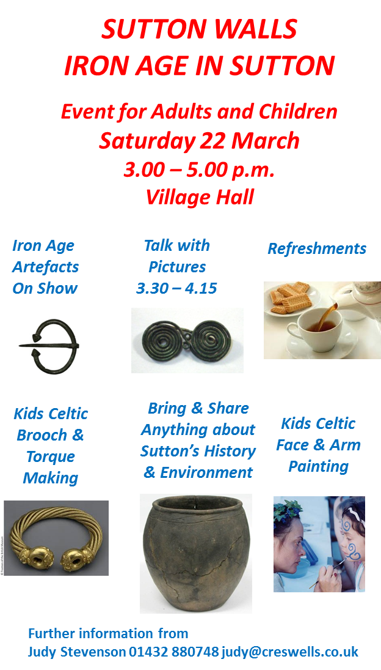
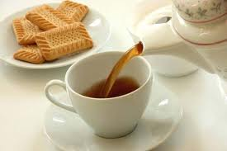
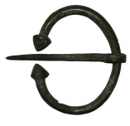
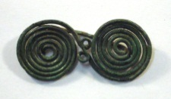
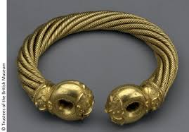
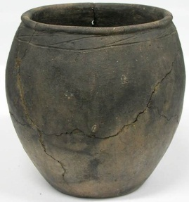
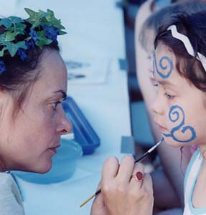
SUTTON WALLS
IRON AGE IN SUTTON
Event for Adults and Children
Saturday 22 March
3.00 – 5.00 p.m.
Village Hall
Iron Age
Artefacts
On Show
Talk with
Pictures
3.30 – 4.15
Refreshments
Kids Celtic
Brooch &
Torque
Making
Bring & Share
Anything about
Sutton’s History
& Environment
Kids Celtic
Face & Arm
Painting
Further information from
Judy Stevenson 01432 880748 judy@creswells.co.uk

